Slide 1
Financial Modeling
The Meteoric Rise of Tesla (TSLA)
Dhruv Srikanth

Slide 2
Table of Contents
Objectives
Motivation
Datasets
Software
Approach
References

Slide 3
Objectives
Understand the rise in stock price of Tesla between 2010 and 2020
Investigate the effect of Elon Musk’s social media presence on the price of the stock
Create a model to predict Tesla’s stock price

Slide 4
Motivation
To investigate Tesla as a sentiment driven stock
Gain deeper insight on factors that influence a stock’s future value
To potentially augment automated trading bots with sentiment analysis

Slide 5
Datasets
Stock Price Kaggle Dataset - https://www.kaggle.com/timoboz/tesla-stock-data-from-2010-to-2020
This contains Tesla’s stock price over 10 years from 2010 to 2020 (by day)
The dataset will be augmented with sentiment information on Elon Musk’s tweets
Elon Musk Tweet Kaggle Dataset - https://www.kaggle.com/ayhmrba/elon-musk-tweets-2010-2021

Slide 6
Software
Language - Python
Environment - Google Colab, jupyter notebook
Modules -
Model Creation - sklearn, statsmodels, tensorflow (keras)
Utility - pandas, numpy, scipy
Visualization - matplotlib, seaborn, plotly
Sentiment Analysis - vaderSentiment

Slide 7
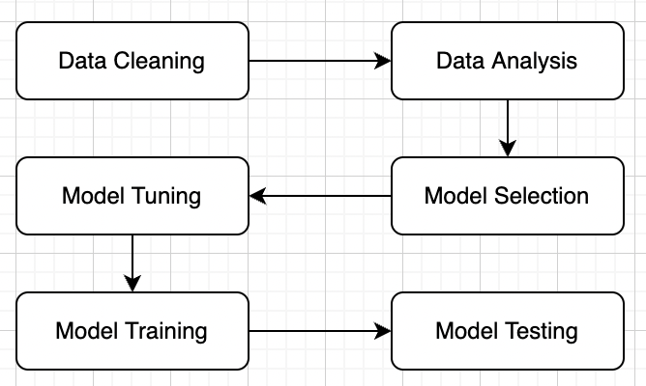
Approach

Slide 8
References
Tesla Stock Dataset - https://www.kaggle.com/timoboz/tesla-stock-data-from-2010-to-2020
Elon Musk Tweets Dataset - https://www.kaggle.com/ayhmrba/elon-musk-tweets-2010-2021
Stock Prediction using Sentiment analysis and Long Short Term Memory - https://ejmcm.com/ pdf_3126_16b444b632c88db6fed0c6558dd6930a.html
Harvesting social media sentiment analysis to enhance stock market prediction using deep learning - https://www.ncbi.nlm.nih.gov/pmc/articles/PMC8053016/

